Slide 1

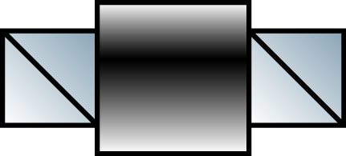

LASER
Isolator
Beam Splitter
Polarization
Controller

